Slide 1
Class 1: Introduction to Causal Thinking
Causal Analysis for Public Policy and Social Science — QMSS 75000 / SOC 81900
CUNY Graduate Center — Fall 2026
Edwin Grimsley, Ph.D.
Notes:
Welcome students as they arrive. Briefly introduce yourself — your background (ACLU Immigrants' Rights Project, Innocence Project, sociology PhD) helps students see why this course treats causal inference as a design problem, not just a stats requirement. Mention this is Session 1: logistics first, then a real intro to causal thinking, then next week starts R.

Slide 2
What Is This Course About?
An introduction to causal inference methods for public policy and social science research.
Methods designed to assess the impact of a potential cause — a policy, an intervention, an institutional change — on an outcome.
You will learn the modern causal inference toolkit: experiments, regression & matching, weighting, fixed effects, difference-in-differences, instrumental variables, regression discontinuity, and spatial/boundary designs.
Applications from sociology, criminal justice, education, housing, immigration, and public health.
Notes:
Emphasize the breadth of the toolkit up front so students see the whole arc of the semester, not just week-to-week topics. If time allows, ask 1-2 students what causal question brought them to the course — primes the 'research interests' discussion slide later.

Slide 3
Goals
Understand and use the core tools of modern causal inference.
Diagnose problems and assumptions underlying a causal claim.
Read and critically evaluate causal research in applied social science and policy.
Build enough foundation to design and defend your own causal research.
Notes:
Frame goal 4 as the throughline: everything builds toward the final paper. Worth saying explicitly that by Week 11 they'll already have a paper outline — this isn't a last-minute scramble.

Slide 4
Course Readings
This course is ZTC (“Zero Textbook Cost”) — all readings are free, on Brightspace or linked directly.
Rosenbaum, Paul R. (2023)
Causal Inference
The MIT Press
Huntington-Klein, Nick (2025)
The Effect: An Introduction to Research Design and Causality
Free online — theeffectbook.net
Notes:
Stress ZTC explicitly — students often don't realize this until they've already budgeted for books. Huntington-Klein's is the one they'll use most (weekly problem sets draw from it); Green and Rosenbaum are more reference-style, pulled from for specific weeks (experiments, matching/weighting).

Slide 5
R
We will use R in lectures, labs, and assignments — every week.
No prior R experience required, but come ready to be challenged and to learn by doing.
Labs each week walk through the code together before it shows up in homework.
Bring a laptop with R and RStudio installed to every class.
Notes:
Reassure students who haven't used R before — next week's lab is a full refresher. If anyone doesn't have R/RStudio installed tonight, point them to posit.co/download/rstudio-desktop and note that tonight's lab is low-stakes (no submission) precisely so install hiccups don't cost them.

Slide 6
Grading
Labs
15%
In-class applied exercises, one per week
Homework
50%
7 coding problem sets + 2 design memos
Final paper presentation
5%
Week 14
Final paper
30%
Grounded in your Week 11 research outline
Notes:
Note that 2 of the 9 homeworks are design memos (Weeks 6 and 8) rather than code — worth flagging so students don't assume every homework is a coding problem set. No separate homework in Weeks 1, 10, or 13.

Slide 7
Final Paper
A causal-inference research paper applying methods from the course to an empirical policy or social science question.
Week 11 homework is your outline: research question, data, and analysis plan — the paper builds directly from it.
Replication extension, dissertation chapter design, or a program evaluation proposal are all welcome directions.
Focus is on research design, data, methodology, and results — not polish for its own sake.
Presented in Week 14.
Notes:
Encourage students to start thinking about a topic now, even loosely — by Week 11 they'll need a real outline, and it's much easier if they've been carrying a question around for 10 weeks rather than inventing one cold. Mention dissertation-stage students can and should use this to advance an actual chapter.

Slide 8
Other Logistics
Syllabus, readings, and all assignments posted on Brightspace
Office hours: details TBD on Brightspace
Slides posted before each class — download them beforehand
Notes:
Fill in office hours day/time and any TA info here before presenting — currently a placeholder. Consider adding a Calendly-style signup link if you plan to use one.

Slide 9
Questions
Any questions about logistics?
Notes:
Pause here for real — let silence sit a few seconds before moving on. This is the natural break between administrative content and the actual causal-thinking material that follows.

Slide 10
Causal Inference
Most of the questions we study and the claims we make in the social sciences are causal in nature.
What is the effect of small class sizes on educational achievement?
Without an intervention that changed class sizes, what's the problem with comparing students already in large vs. small classes?
If a whole school moves to smaller classes, what's the problem with comparing scores before and after?
We want the counterfactual: what test scores would have been had class size not changed, all else equal.
Notes:
Let students answer the two embedded questions out loud before revealing the counterfactual framing — they'll usually get to 'selection' and 'other things changed too' on their own, which sets up the rest of the deck naturally.

Slide 11
Causal Inference — Applications
Sampson, R.J. & Sharkey, P. (2008). Neighborhood selection and the social reproduction of concentrated racial inequality. Demography.
Harding, D.J. (2003). Counterfactual models of neighborhood effects. American Journal of Sociology.
Sharkey, P. & Torrats-Espinosa, G. (2017). The effect of violent crime on economic mobility. Journal of Urban Economics.
Sharkey, P., Torrats-Espinosa, G. & Takyar, D. (2017). Community and the crime decline: local nonprofits and violent crime. American Sociological Review.
Kirk, D.S. (2009). A natural experiment on residential change and recidivism: lessons from Hurricane Katrina. American Sociological Review.
Legewie, J. & Fagan, J. (2019). Aggressive policing and the educational performance of minority youth. American Sociological Review.
Notes:
The Legewie & Fagan paper is the one students will actually replicate in Week 8, so it's worth pointing that out here as a preview. No need to summarize every citation — just gesture at the range (neighborhood effects, crime, policing) and note these are all examples of researchers solving the same identification problem we just discussed.

Slide 12
Examples from your own research interests — let's hear a few.
Causal Inference
Notes:
Go around the room or call on a few volunteers. Listen for whether their stated interest is already phrased causally ('the effect of X on Y') or still descriptive — gently note the difference without correcting anyone; that distinction is literally what Week 11's workshop is for.

Slide 13
Our Approach to Science in This Class
Model of the quantitative research process:
Step 1
Theory motivates a causal hypothesis or target of inference
If we manipulate X, we observe some effect on Y.
Step 2
Hypothesis + theory motivate the research design
How to operationalize X and Y, and how to get useful variation given logistical and ethical constraints.
Step 3
Research design motivates the analysis plan
The estimation and testing strategy that follows from the design — not the other way around.
Notes:
The key point to land: design comes before estimation, always. This is the course's core commitment stated in the syllabus ('design before estimation') — worth explicitly connecting this slide to that language so students hear it twice.

Slide 14
Causal Identification: Spurious Correlations
Two time series can track each other closely for years with no causal connection at all — both simply trending upward (or cyclically) for unrelated reasons.
A high correlation coefficient tells you nothing about whether one variable causes the other, or whether both are driven by a shared trend, a common season, or pure coincidence.
This is why the course cares less about 'is there a correlation' and more about 'what design would let us rule out the alternative explanations.'
Notes:
If you want a live visual, pull up tylervigen.com/spurious-correlations on screen and click through 2-3 examples — students find this genuinely funny and it makes the abstract point concrete. Not embedded in the slide itself for licensing reasons, but totally fine to browse live.

Slide 15
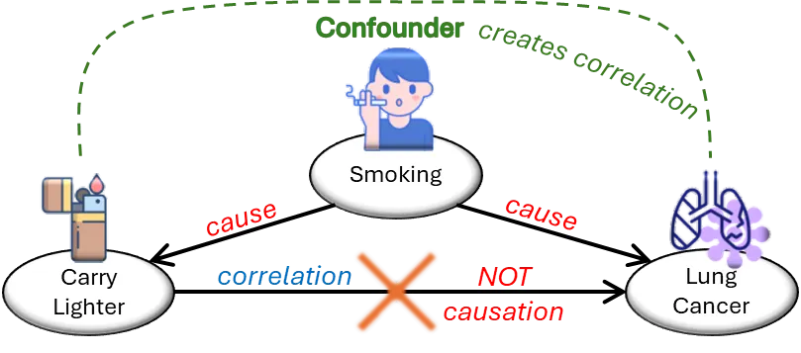

Slide 16
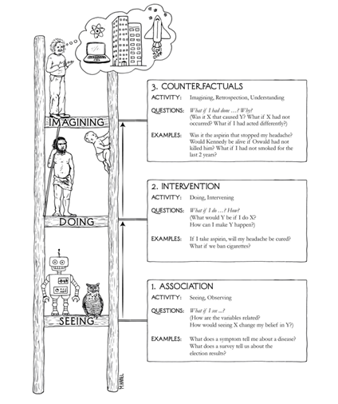

Slide 17
Correlations for causal inference are often spurious — driven by selection effects or confounding factors, not the causal process under investigation.
Correlation is neither necessary nor sufficient for causation — though it can still motivate a causal study.
Correlation and Causation
r = −1
r = +1
r = 0.00
Notes:
The r=0.00 panel is the most useful teaching moment — point out that it's not 'no pattern,' it's a clear inverted-U pattern that Pearson's r simply can't see. Good segue: 'correlation coefficients only capture linear relationships, which is one more reason not to over-trust them.'

Slide 18
Causal Identification
Data
Assumptions
Conclusions
Identification depends on assumptions, not estimation methods. If an effect isn't identified, no estimation technique will recover it — regression, matching, weighting, and 2SLS are all secondary to the identifying assumptions.
Notes:
This is arguably the single most important slide in the whole semester — consider pausing longer here than anywhere else. The phrase 'what's your identification strategy?' is the question every method in this course is trying to answer; students should leave tonight able to repeat that phrase back to you.

Slide 19
Causation and Manipulation
Holland (1986): for causal inference, a unit needs to be potentially exposable to any of the causes under study — summarized in his well-known phrase, “no causation without manipulation.”
The problem of ambiguous counterfactuals is usually resolved by focusing on hypothetical manipulations in the world as it is (Angrist & Krueger 1999).
This gets tricky for things like race or gender, which can't literally be manipulated.
One fix: reframe the question — not “the effect of race on …” but “the effect of racial discrimination on …”
Notes:
This is a good moment to connect to the Legewie & Fagan paper and the course's own policing/housing case material — 'racialized policing' framings in this course are already built around discrimination/enforcement as the manipulable treatment, not race itself. Worth naming that explicitly so students see the course practicing what this slide preaches.

Slide 20
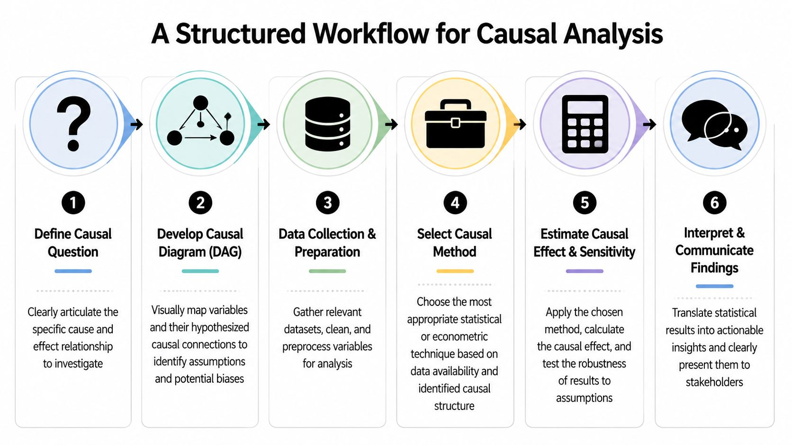

Slide 21
Ten Things to Know About Causal Inference (1–5)
Adapted from Macartan Humphreys, EGAP — egap.org/resource/10-things-to-know-about-causal-inference
A causal claim is about what didn't happen.
“X caused Y” means Y wouldn't have happened without X — a claim about a counterfactual, not just about what was observed.
There's a fundamental problem of causal inference.
You can arrange to see what happens with or without treatment, but never both for the same unit at once.
You can estimate average effects without observing any individual effect.
The average causal effect is the gap between the average outcome across units in each condition — even though no single unit reveals its own effect.
“A causes B” and “B causes C” doesn't mean “A causes C.”
Average causal relationships aren't guaranteed to chain together this way.
Causes are non-rival.
Multiple things can each independently be “the” cause of an outcome; their effects don't have to sum to 100%.
Notes:
Points 2 and 3 together are the setup for Week 3's potential-outcomes notation — flag that connection explicitly. Point 5 (non-rival causes) is the one students most often get wrong on exams/memos later, so it's worth a concrete example: a fire needs both oxygen and fuel, and both are fully 'causes,' not 50% each.

Slide 22
Ten Things to Know About Causal Inference (6–10)
Learning “effects of a cause” is easier than “causes of an effect.”
You can often say what X does to Y on average, even when you can't say why a specific outcome happened.
Correlation isn't causation.
A correlation describes actual outcomes in the world, not the gap between actual and counterfactual outcomes — cough medicine correlates with coughing, but doesn't cause it.
X can cause Y without being necessary or sufficient for Y.
Causation can be probabilistic (X raises the chance of Y) or conditional (X causes Y only given some other condition).
Treatment and control groups don't need to be identical.
Randomization balances groups in expectation, not necessarily in any single realized sample.
No causation without manipulation.
A causal claim needs a coherent counterfactual — which is why claims like “he got the job because he's Peter” are hard to interpret causally, and why some effects (like race) get reframed around a manipulable mechanism instead.
Notes:
Point 9 (treatment/control don't need to be identical) previews Week 4's balance-check discussion — worth a one-line flag ('we'll formalize this with real balance tables in two weeks'). Point 10 closes the loop back to the manipulation slide — good place to end and transition to closing/questions.

Slide 23
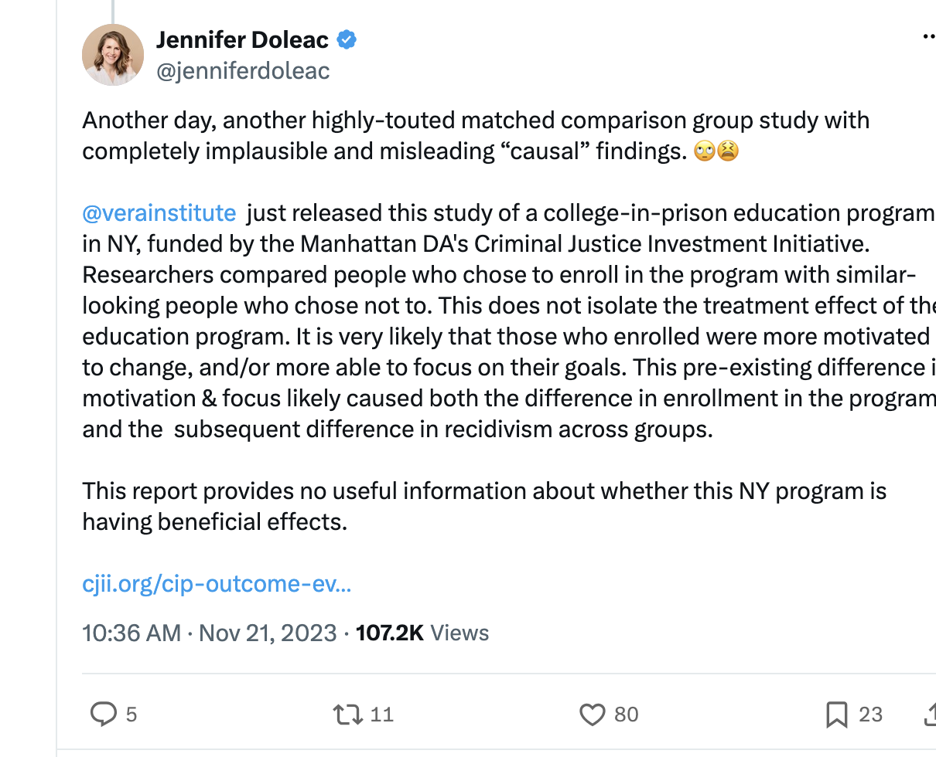

Slide 24
Questions?
Next Week: R Refresher & Regressions set up.
Notes:
Close by reminding students to install R/RStudio before next week if they haven't, and that Lab 1 next week is genuinely no-stakes — lowers anxiety for anyone rusty or new to R.

